Slide 1
MID-TERM PROJECT: INSTAGRAM ENGAGEMENT ANALYSIS FOR NOMAD CONNECTs
By: Susan Ndinoshinge
11/11/2023
Barcelona, Spain
Ironhack Campus

Slide 2
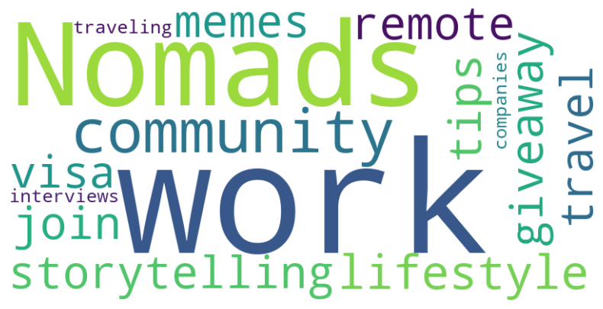
Introduction
Overview of Nomads Connect Community:
Founded by Michelle Smit, born from her travel and work challenges, including visa issues. Nomad Connects is a global hub for digital nomads, fostering community, knowledge-sharing, and support in the world of remote work and travel.

Slide 3
Instagram & Nomad Connects
Most important ‘ tool’ to get publicity & let the network grow
Financial benefits → sponsors & partnership
Followers are important, but shares , comments and likes even more!
→ Active followers who want to help the community grow

Slide 4
Instagram how to reach followers?
No Pictures, but reels! 99% of Nomad Connects’ Instagram is reels
→ Focus of my research is on ‘reels’
But which kind of posts content will attract followers?

Slide 5

Research question:
Which kind of ‘posts content’ gives the best results based on input and results?
Purpose:
Analyse Instagram engagement to fuel growth.

Slide 6
METHODOLOGY
Data analyses for 5 kind of content post related to ‘Likes’, ‘Comments’ and ’Shares’. Results/output
Questionnaire to the company owner how much work is put in for each post content. Input/investment
I scored the Output/results and the input/investment.
five-Month Analysis Period
Tools: Excel, Social Media Analytics, Python (word cloud), Questionnaire

Slide 7
5 kinds of posts content
Giveaways
Giveaways-congrats
Join
Memes
Tips

Slide 8
Shares, likes and Comments; What is the importancy?
Shares
Increase content reach
Attracting potentially new followers ‘ Real Nomads'
Comments
Active engagement
Level of interest
Likes
Signifies apporval and appreciation
A sign that people are involved

Slide 9
Clean data
Post content | Total likes | Total comments | Total shares | Amount of post
Giveaway | 10.229 | 14.562 | 2350 | 8
Giveaway-cograts | 13.329 | 15.020 | 2494 | 8
Join | 28.855 | 16.990 | 3311 | 65
Tips | 33.813 | 23.227 | 4338 | 126
Meme | 22.206 | 16.713 | 3066 | 20
TOTAL | 108.432 | 86.512 | 15.559 | 227

Slide 10
Data overview ‘ scores’
Post content | % AVG on total Likes | % AVG on total comments | % AVG on total shares | total. AVG score %* | Score result
Giveaway | 27% | 37% | 35% | 33% | 33
Giveaway-cogratz | 35% | 38% | 37% | 37% | 37
Join | 9% | 5% | 6% | 7% | 7
TIPS | 6% | 4% | 4% | 4% | 4
Meme | 23% | 17% | 18% | 19% | 19

Slide 11
Sub Conclusion
Giveaway scores amazingly on all levels! Why not just give away? We only had 8!
Giveaway congrats doing even better. Why? Because maybe people acknowledge that Nomads Connect is real!
Memes also scores great! Who does not like a great joke?!
‘ Tips’ & ‘Joins’ scoring low...
....BUT….

Slide 12
Sub Conclusion (2)/ Questionnaire
Not all posts are equally quick and easy to create..
Therefore:
Questionnaire with Nomad Connects owner Michelle:
Which type of ‘posts content’ has the highest:
- amount of work (effort) to create the content
- investment €

Slide 13
Result Questionnaire
Post content | Amount of work | Investment | Total value investment
Giveaway | 10 | 10 | 20
Giveaway-cograts | 6 | 10 | 16
Join | 2 | 4 | 6
TIPS | 2 | 2 | 4
Meme | 3 | 3 | 6

Slide 14
Scores: Result- investment = Total score
Post content | Scores result post content (Data) | Score investment post content | Total score result
Giveaway | 33 | 20 | 13
Giveaway-congrats | 37 | 16 | 21
Join | 7 | 6 | 1
TIPS | 4 | 4 | 0
Meme | 19 | 6 | 13
->> Giveaway congrats excluded (No giveaway, no congrats☺)

Slide 15
Conclusion
Memes & Giveaways scores the best! It’s a draw!
We LOVE shares → Memes and Giveaways are the Share givers.
Meme’s do not require a lot of investment!
Does this say that Nomad connects should only post giveaways and memes? NO! Tips and Joins are also important!
Why? → Easy and cheap to make. Signifies apporval and appreciation & fill up the Instagram.
→ More Giveaways and Memes will attract more Active & involved ‘Nomads’ , Increase content reach and helps Nomad Connects grow.

Slide 16

THANK YOU
-SUSAN NDINOSHINGE
Follow their instagram
@nomadconnectscommunity

